Slide 1
Accelerating DETR Convergence via Semantic-Aligned Matching
Gongjie Zhang1 Zhipeng Luo1,2 Yingchen Y u1 Kaiwen Cui1 Shijian Lu*1 1Nanyang Technological University, Singapore 2SenseTime Research {gongjiezhang, shijian.lu}@ntu.edu.sg {zhipeng001, yingchen001, kaiwen001}@e.ntu.edu.sg
CVPR 2022

Slide 2
摘要
The recently developed DEtection TRansformer (DETR) establishes a new object detection paradigm by eliminating a series of hand-crafted components. However , DETR suffers from extremely slow convergence, which increases the training cost significantly. We observe that the slow convergence is largely attributed to the complication in matching object queries with target features in different feature embedding spaces. This paper presents SAM-DETR, a Semantic-Aligned-Matching DETR that greatly accelerates DETR’s convergence without sacrificing its accuracy.SAM-DETR addresses the convergence issue from two perspectives. First, it projects object queries into the same embedding space as encoded image features, where the matching can be accomplished efficiently with aligned semantics. Second, it explicitly searches salient points with the most discriminative features for semantic-aligned matching, which further speeds up the convergence and boosts detection accuracy as well. Being like a plug and play, SAM-DETR complements existing convergence solutions well yet only introduces slight computational overhead. Extensive experiments show that the proposed SAM-DETR achieves superior convergence as well as competitive detection accuracy. The implementation codes are publicly available at
https://github.com/ZhangGongjie/SAM-DETR .
DETR (DEtection TRansformer) 通过消除手工组件（例如anchor）建立了一种新的目标检测框架。然而，DETR的收敛速度非常慢，大大增加了训练成本。我们观察到，在不同的特征嵌入空间(feature embedding spaces) 中，object query 与目标特征之间匹配的复杂性是导致收敛缓慢的主要原因。 本文提出 SAM-DETR，一种语义对齐匹配 (Semantic-Aligned-Matching) DETR，能在不牺牲精度的情况下极大加快 DETR 的收敛速度。SAM-DETR从两个方面解决了 DETR 收敛速度慢的问题：
1.首先，它将 object query 投影到与编码图像特征相同的嵌入空间(embedding space)，通过对齐语义有效地完成匹配。
2.它显式地搜索最具辨别力特征的显著点进行语义对齐匹配，这进一步加快了收敛速度并提高了检测精度。
SAM-DETR 是一个即插即用的解决方案，在只引入少量计算开销的前提下很好地补充了现有的收敛解决方案。大量实验表明，SAM-DETR 不仅具有很好的收敛性，而且具有很高的检测精度。

Slide 3
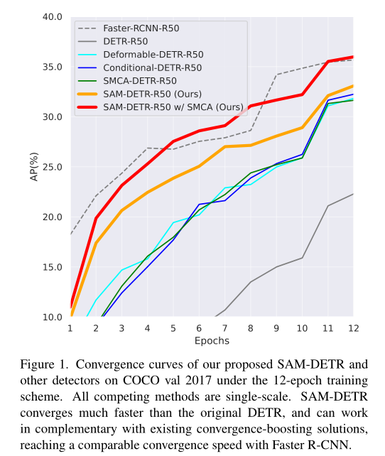

Slide 4
贡献总结
This paper proposes SAM-DETR to accelerate DETR’s convergence. At the core of SAM-DETR is a plug-and-play module that semantically aligns object queries and encoded image features to facilitate the matching between them. It also explicitly searches salient point features for semantic-aligned matching. The proposed SAM-DETR can be easily integrated with existing convergence solutions to boost
performance further, leading to a comparable accuracy with Faster R-CNN within 12 training epochs. We hope our work paves the way for more comprehensive research and applications of DETR.
In summary, the contributions of this work are four- fold. First, we propose Semantic-Aligned-Matching DETR (SAM-DETR), which significantly accelerates DETR’s con- vergence by innovatively interpreting its cross-attention as a ‘matching and distillation’ process and semantically aligning object queries with encoded image features to facilitate their matching. Second, we propose to explicitly search for objects’ salient points with the most discriminative features and feed them to the cross-attention module for semantic-aligned matching, which further boosts the detection accuracy and speeds up the convergence of our model. Third, experiments validate that our proposed SAM-DETR achieves significantly faster convergence compared with the original DETR. F ourth, as our approach only adds a plug-and-play module into the original DETR and leaves other operations mostly unchanged, the proposed SAM-DETR can be easily integrated with existing solutions that modify the attention mechanism to further improve DETR’s convergence, leading to a comparable convergence speed with Faster R-CNN even within 12 training epochs.
本文提出SAM-DETR来加速DETR的收敛。SAM-DETR的核心是一个即插即用模块，它在语义上对齐对象查询和编码图像特征，以便于它们之间的匹配。它还显式地搜索语义匹配的显著点特征。
AM-DETR可以轻松地与现有的收敛解决方案集成，以进一步提高性能，从而在12个训练周期内获得与更快的R-CNN相当的精度。
1. 我们提出了语义对齐匹配DETR（SAM-DETR），通过创新性地将其交叉注意解释为“匹配和提取”过程，并将对象查询与编码图像特征进行语义对齐，以便于匹配，从而显著加快DETR的收敛。
2. 我们建议显式搜索具有最具辨别力特征的对象的显著点，并将其反馈给交叉注意模块进行语义匹配，这进一步提高了检测精度并加快了模型的收敛速度
3.实验验证了我们提出的SAM-DETR比原DETR具有更快的收敛速度。
4.由于我们的方法只在原始DETR中添加了一个即插即用模块，其他操作基本保持不变，因此拟议的SAM-DETR可以很容易地与现有解决方案集成，这些解决方案修改了注意机制，以进一步提高DETR的收敛速度，甚至在12个训练周期内，也可以与更快的R-CNN实现相当的收敛速度。

Slide 5
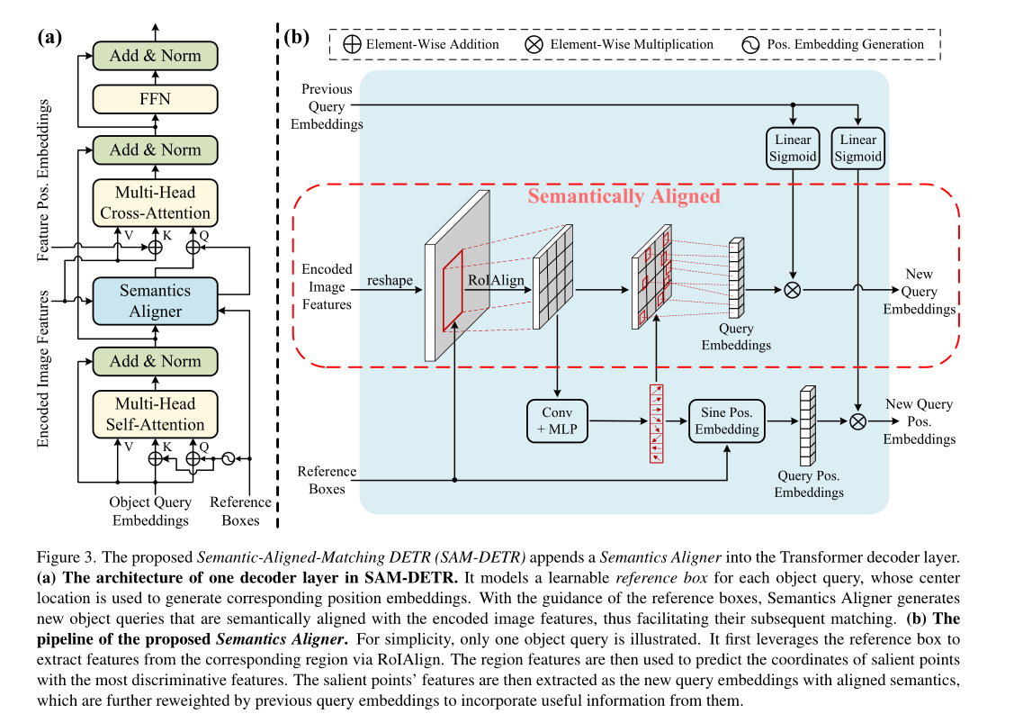
结构图

Slide 6
SAM-DETR
Our proposed SAM-DETR aims to relieve the difficulty of the matching process in Eq. 1 by semantically aligning object queries and encoded image features into the same embedding space, thus accelerating DETR’s convergence. Its major difference from the original DETR [3] lies in the Transformer decoder layers. As illustrated in Fig. 3 (a), the proposed SAM-DETR appends a Semantics Aligner module ahead of the cross-attention module and models learnable reference boxes to facilitate the matching process. Same as DETR, the decoder layer is repeated six times, with zeros as input for the first layer and previous layer’s outputs as input for subsequent layers.
The learnable reference boxes Rbox ∈ RN×4 are mod- eled at the first decoder layer, representing the initial locations of the corresponding object queries. With the localization guidance of these reference boxes, the proposed Semantics Aligner takes the previous object query embeddings Q and the encoded image features F as inputs to generate new object query embeddings Qnew and their position embeddings Qnewpos , feeding to the subsequent crossattention module. The generated embeddings Qnew are enforced to lie in the same embedding space with the encoded image features F, which facilitates the subsequent matching process between them, making object queries able to quickly and properly attend to relevant regions in the encoded image features.
我们提出的SAM-DETR旨在通过将对象查询和编码图像特征语义对齐到相同的嵌入空间，从而加速DETR的收敛，从而缓解等式1中匹配过程的困难。它与原DETR的主要区别在于变压器解码器层。如图3（a）所示，拟议的SAM-DETR在交叉注意模块之前附加了语义对齐器模块，并对可学习参考框进行建模，以促进匹配过程。与DETR相同，解码器层重复六次，零作为第一层的输入，前一层的输出作为后续层的输入。可学习参考框Rbox∈ RN×4在第一解码器层建模，表示相应对象查询的初始位置。在这些参考框的定位指导下，所提出的语义对齐器将先前的对象查询嵌入Q和编码图像特征F作为输入，生成新的对象查询嵌入Qnew及其位置嵌入Qnewpos，并将其馈送给后续的交叉注意模块。生成的嵌入Qnew被强制与编码图像特征F位于相同的嵌入空间中，这有助于它们之间的后续匹配过程，使得对象查询能够快速而正确地关注编码图像特征中的相关区域。
Q
K
K
V
V

Slide 7
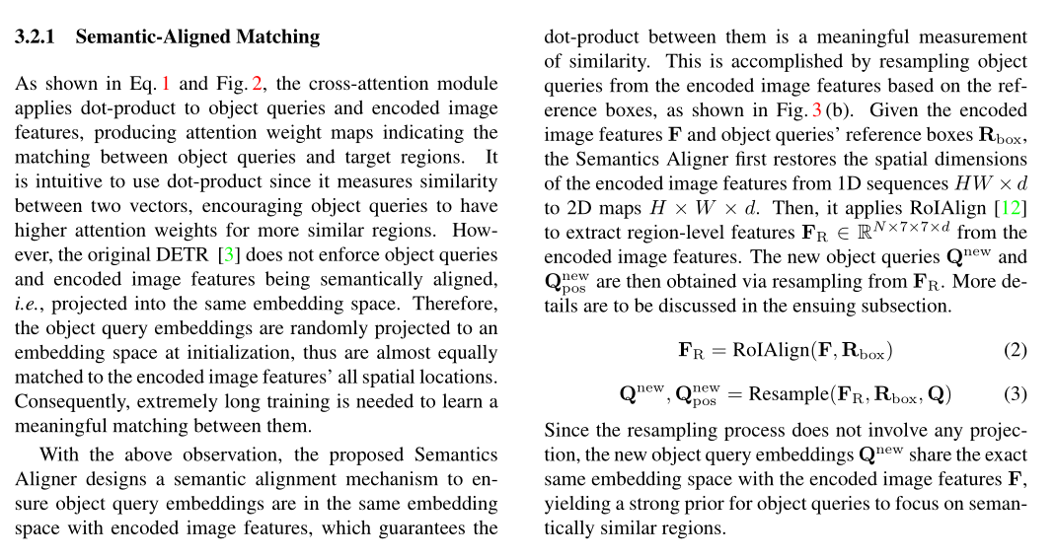
语义对齐匹配 Semantic-Aligned Matching

Slide 8
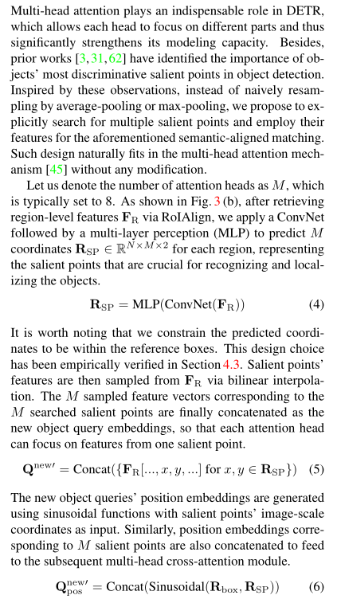

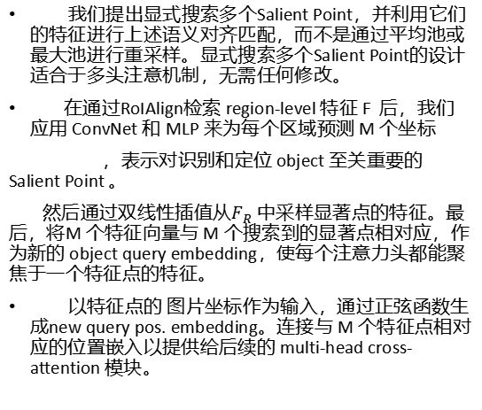
显著点特征匹配 Matching with Salient Point Features
我们提出显式搜索多个Salient Point，并利用它们的特征进行上述语义对齐匹配，而不是通过平均池或最大池进行重采样。显式搜索多个Salient Point的设计适合于多头注意机制，无需任何修改。
在通过RoIAlign检索 region-level 特征 F 后，我们应用 ConvNet 和 MLP 来为每个区域预测 M 个坐标
，表示对识别和定位 object 至关重要的 Salient Point 。
然后通过双线性插值从$F_{R}$ 中采样显著点的特征。最后，将M 个特征向量与 M 个搜索到的显著点相对应，作为新的 object query embedding，使每个注意力头都能聚焦于一个特征点的特征。
以特征点的 图片坐标作为输入，通过正弦函数生成new query pos. embedding。连接与 M 个特征点相对应的位置嵌入以提供给后续的 multi-head cross-attention 模块。

Slide 9
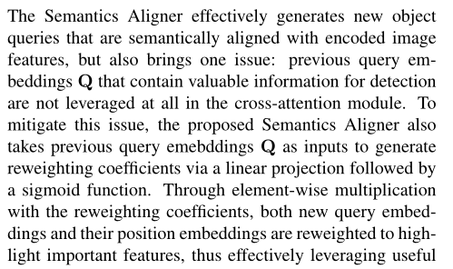
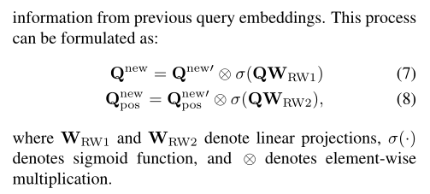
Reweighting by Previous Query Embeddings
语义对齐器 Semantics Aligner 可以有效地生成新的 object query，这些 query 在语义上与编码的图像特征保持一致，但也带来了一个问题：在 cross-attention 模块中根本没有利用包含有价值检测信息的previous query embeddings Q 。
为解决此问题，语义对齐器将previous query embeddings作为输入，通过线性投影和 sigmoid 函数生成重加权系数。通过元素相乘和重加权系数，new object query embeddings和position embeddings都被重加权，以突出重要特征，因此，可以有效地利用 previous query embeddings Q 中的有用信息。
W RW1 和 W R W 2表示线性映射，σ ( . ) 表示sigmoid函数，⊗表示元素乘法。

Slide 10
对比SMCA-DETR Compatibility with SMCA-DETR
As illustrated in Fig. 3 (a), our proposed SAM-DETR only adds a plug-and-play module with slight computational overhead, leaving most other operations like the attention mechanism unchanged. Therefore, our approach can easily work with existing convergence solutions in a complementary manner to facilitate DETR’s convergence further. We demonstrate the excellent compatibility of our approach by integrating it with SMCA-DETR [10], a state-of-the-art method to accelerate DETR’s convergence. SMCA-DETR [10] replaces the original cross-attention with Spatially Modulated Co-Attention (SMCA), which estimates the spatial locations of object queries and applies 2D-Gaussian weight maps to constrain the attention responses. In SMCA-DETR [10], both the center locations and the scales for the 2D-Gaussian weight maps are predicted from the object query embeddings. To integrate our proposed SAM-DETR with SMCA, we make slight modifications: we adopt the coordinates of M salient points predicted by Semantics Aligner as the center locations for the 2D Gaussian-like weight maps, and simultaneously predict the scales of weight maps from pooled RoI features. Experimental results demonstrate the complementary effect between our proposed approach and SMCA-DETR [10].
SAM-DETR 没有改变DETR 中的注意力机制以及大多数操作，只添加了一个即插即用模块，计算开销很小，因此可以与现有的收敛解决方案以互补的方式工作，从而进一步促进DETR的收敛。通过将其与现有的加速 DETR 的 sota 方法：SMCA-DETR相结合，展示了 ours 良好兼容性。
SMCA-DETR 用Spatially Modulated Co-Attention（SMCA）取代了原来的cross-attention，SMCA估计 object query 的空间位置，并应用 2D-Gaussian weight maps 来约束注意力响应。在SMCA-DETR 中，2D-Gaussian weight maps 的中心位置和比例都是通过 object query embedding 来预测的。为了将 SAM-DETR与SMCA相结合，我们做了一些轻微的修改：我们采用语义对齐器预测的 M个显著点的坐标作为 2D-Gaussian weight maps 的中心位置，同时根据 pooled RoI features 预测 weight maps的比例。实验结果证明了 ours 和 SMCA-DETR 之间的互补效应。

Slide 11
可视化分析 Visualization and Analysis
Fig. 4 visualizes the salient points searched by the proposed Semantics Aligner, as well as their attention weight maps generated from the multi-head cross-attention module. We also compare them with the original DETR’s attention weight maps. Both models are trained for 12 epochs with ResNet-50 [13] as their backbones. It can be observed that the searched salient points mostly fall within the target objects and typically are the most distinctive locations that are crucial for object recognition and localization. This illustrates the effectiveness of our approach in searching salient features for the subsequent matching process. Besides, as shown in the attention weight maps from different heads, the sampled features from each salient point can effectively match target regions and narrow down the search range as reflected by the area of attention maps. Consequently, the model can effectively and efficiently attend to the extremities of the target objects as
图4显示了所提出的语义对齐器搜索的显著点，以及从多头交叉注意模块生成的注意权重图。我们还将其与原始DETR的注意力权重图进行了比较。这两个模型都接受了12个时代的训练，以ResNet-50[13]为骨干。可以观察到，搜索的显著点大多位于目标对象内，通常是对对象识别和定位至关重要的最独特的位置。这说明了我们的方法在为后续匹配过程搜索显著特征方面的有效性。此外，如不同头部的注意权重图所示，每个显著点的采样特征可以有效匹配目标区域，并缩小注意图区域所反映的搜索范围。因此，该模型可以有效地处理目标对象的端点

Slide 12
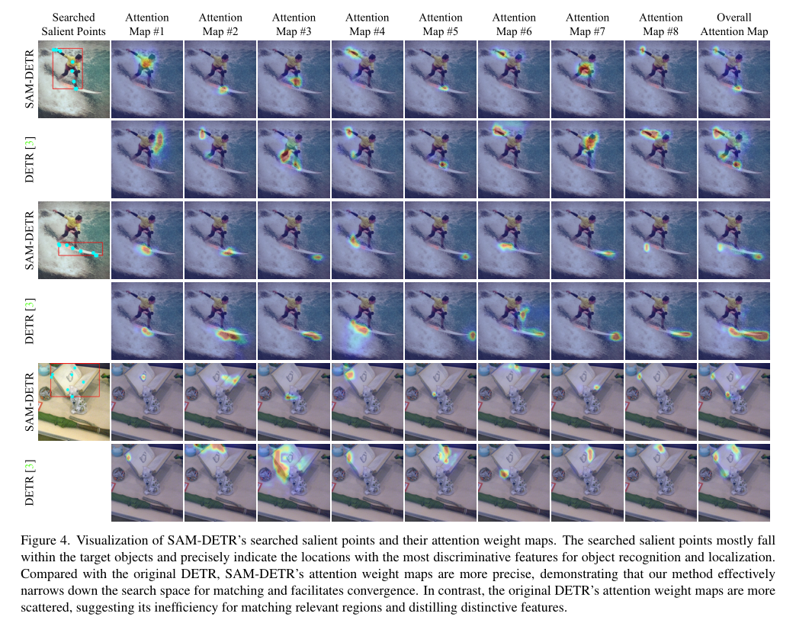

Slide 13
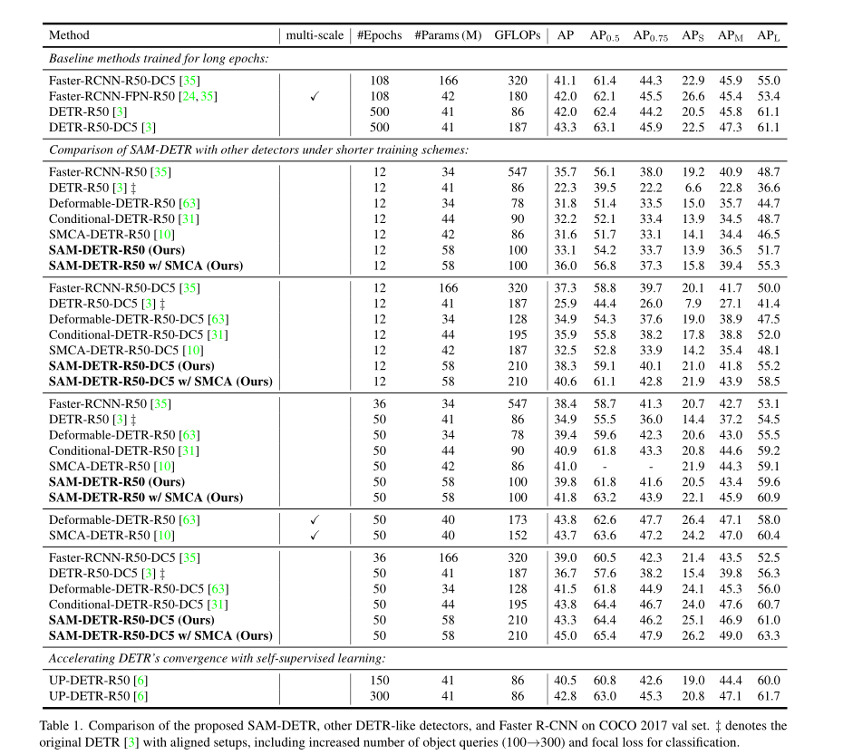
实验

Slide 14
